Slide 1



Welcome
Galway IT 1.3 / Cloud Meetup
Galway IT Meetup

Slide 2
Agenda
 | Topic | Speaker
1 | Opening Remarks & Speaker Introductions | Fergal Hynes / Jennifer Conlon
2 | Domain Driven Design with Microservices in the Cloud | John Lynch
3 | Secure Cloud: Safeguarding your Data | Michael Dunne
5 | Q&A Session
6 | Break - Refreshments Served @ 7:10 PM
6 | IAM: Inane Access Management | Liam Krewer
7 | Effortless Development with Google Project IDX | Tom Prior
8 | Q&A Session
9 | Closing Remarks & Wrap-up
Notes:
Top of Mind - Josh’s Departure
Annette to cover Roles

Slide 3




Speakers
John Lynch
Senior Solution Architect, Signify Health
Michael Dunne
Front-End Developer, Zest Consulting
Liam Krewer
Software Engineer, FleetOps.com
Tom Prior
Staff Engineer, Signify Health
"Domain Driven Design with Microservices in the Cloud"
"Secure Cloud: Safeguarding your Data"
"IAM: Inane Access Management"
"Effortless Development with Google Project IDX"

Slide 4

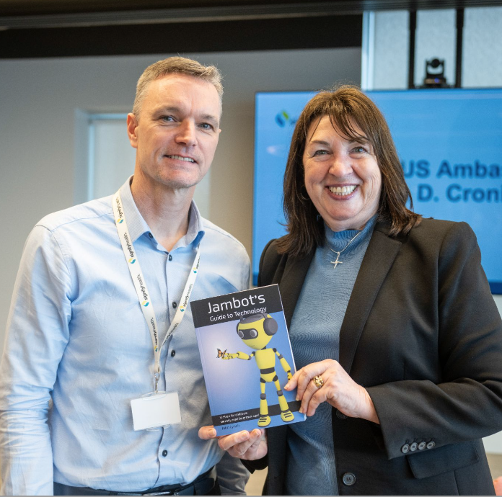
Galway IT Meetup
Domain Driven Design with Microservices in the Cloud
John Lynch
Senior Solution Architect
July 18, 2024
Notes:
I would like to talk to you about IAM: Identity Access Management
I’ll give you a brief overview, a history of how we got here, problems I have with IAM systems and some solutions to those problems.
And I should add - I’m by no means an expert on this. This isn’t as much a talk by a subject matter expert as a commiseration at a complicated technology foisted upon us.

Slide 5
Honestly, microservices seem like a terrible idea, except for all the good stuff.
Sam Newman - Monolith to Microservices
Notes:
Distributed systems are complex.
Our job is not to make things more complicated.
Talk about my own experiences - 2 anti-patterns I’ve seen

Slide 6
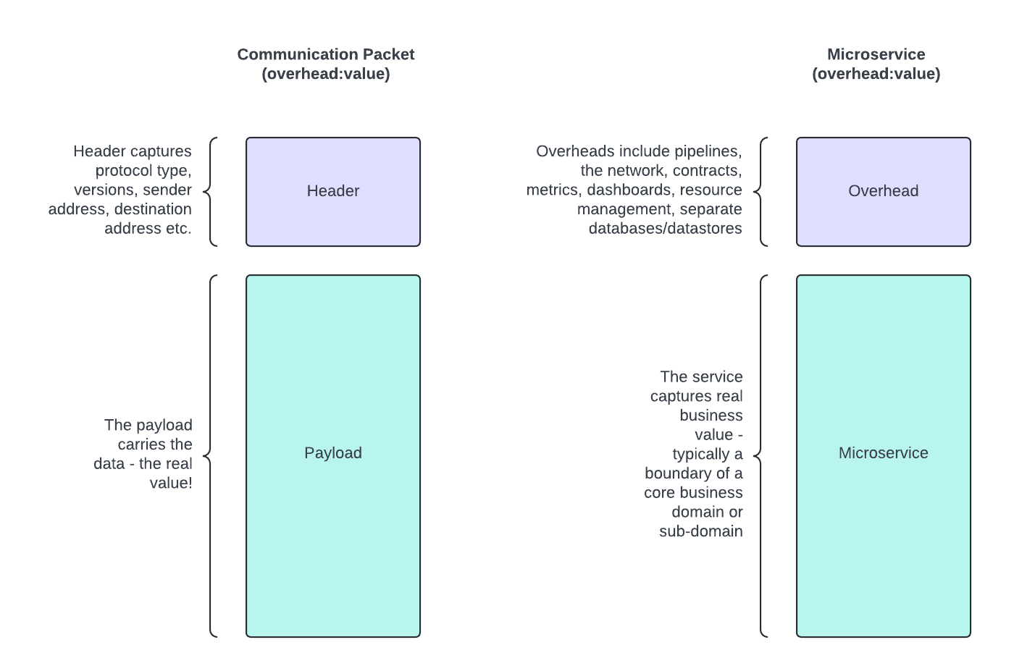
Microservices - the overhead!

Slide 7
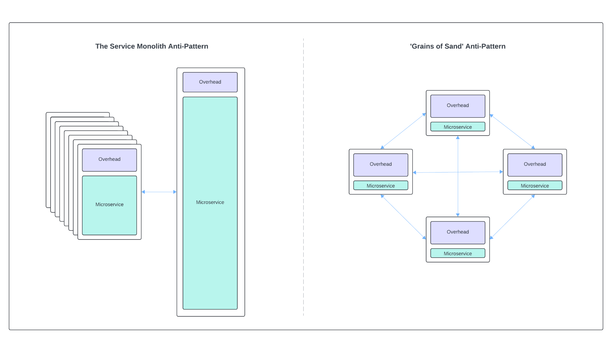
Not to big, not too small, but just right!

Slide 8
The monolith anti-pattern
Characteristics
Very large microservice.
Large database.
Too many responsibilities.
Multiple domains catered for.
Domain boundaries not clear.
Worked on by many teams - no single owner.
Large number of collaborators.
Common Issues
Changes are high risk.
Code is difficult/costly to change.
Changes are difficult to test.
Deploys are very stressful.
Overall code quality & structure is poor.
Continues to grow in size - it has a gravity!
No one person or team have the full picture.
Failures tend to cause large/significant outages.

Slide 9
The ‘grains of sand’ anti-pattern
Characteristics
Very small microservices.
Some have very small databases or no database at all!
Too few responsibilities.
Functional responsibilities - ‘nuts and bolts’.
Lots of communication (sync and async).
Complex interactions at the solution level.
Common Issues
There are many contracts to manage.
Deploys often need to be coordinated.
Individual deploys don’t add clear business value.
Solution quickly becomes complex - more choreography or orchestration.
Solution is ‘network’ prominent.
Consensus and consistency come into play more.
Multiple failure points.
Larger management overhead (pipelines, observability etc.)

Slide 10
An organisation that designs a system will inevitably produce a design whose structure is a copy of the organisation’s communication structure.
Melvin Conway - 1968

Slide 11
What is DDD and how can it help?

Slide 12
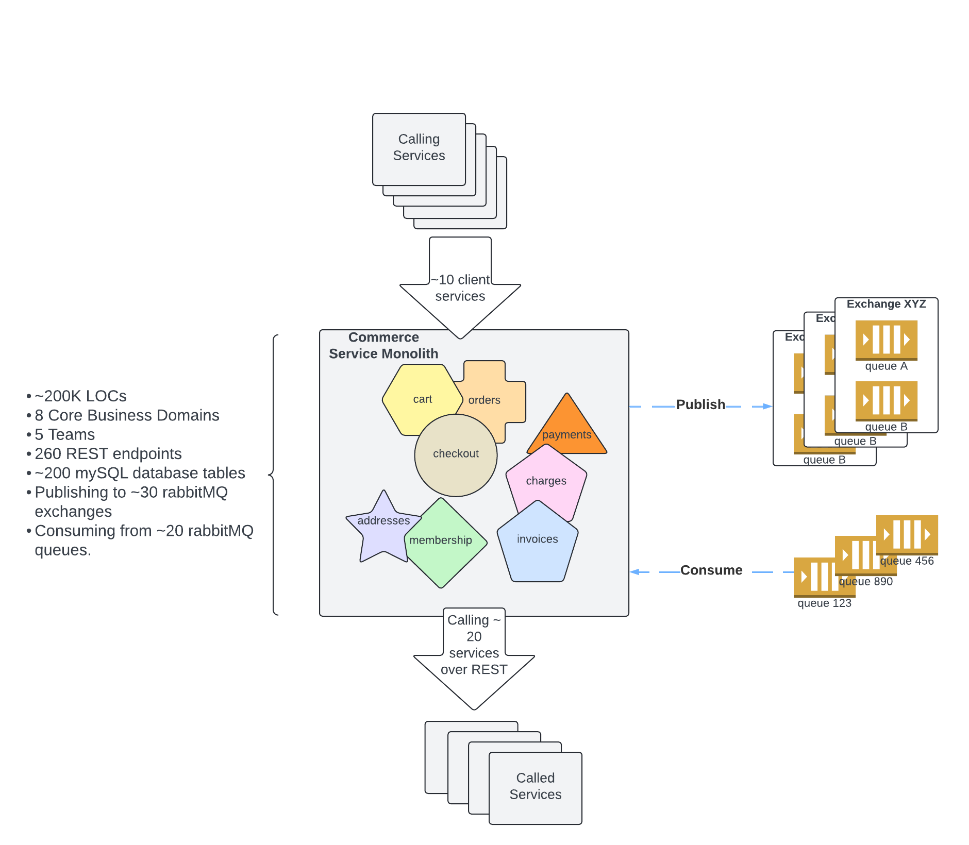
The commerce problem!

Slide 13
DDD - the what and the why
What is DDD?
A ‘domain’ is a software boundary that satisfies/models a business need.​
There are 2 core aspects to a domain:​
A ‘bounded context’​
A ‘ubiquitous language’​
Why use it?
​
Business first - modelling the unique business needs.​
Provide clarity. Avoid the ‘big ball of mud’.​
Helps develop ‘right sized, ‘right value’ services.​

Slide 14
How do we define a domain?
​Define the domain name​
The name makes sense - adds clarity​.
Define the aggregates & entities
Define objects that live in the BC. ​
Modelling - use the ubiquitous language.​
Define transactional boundaries.
Avoid poor/unnecessary abstractions.​
Build small testable units.​
​Define the boundary (bounded context)​
Responsibilities clear; cohesive; well bounded. Not too many; not too few; just right!​​
Agree on the language ​
Language spoken by the team.​
Well documented and understood.​
Traces into the software​.
Developed by looking at scenarios, use cases & object interactions.​
​Context mapping between domains​
Clearly define the collaborators​.
Define relationships & technical interfaces.​
Define APIs / communication patterns​.

Slide 15
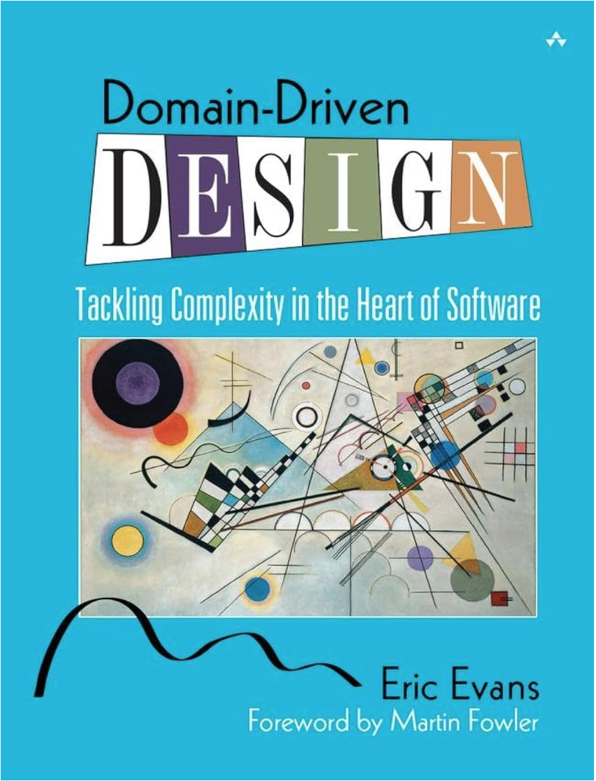
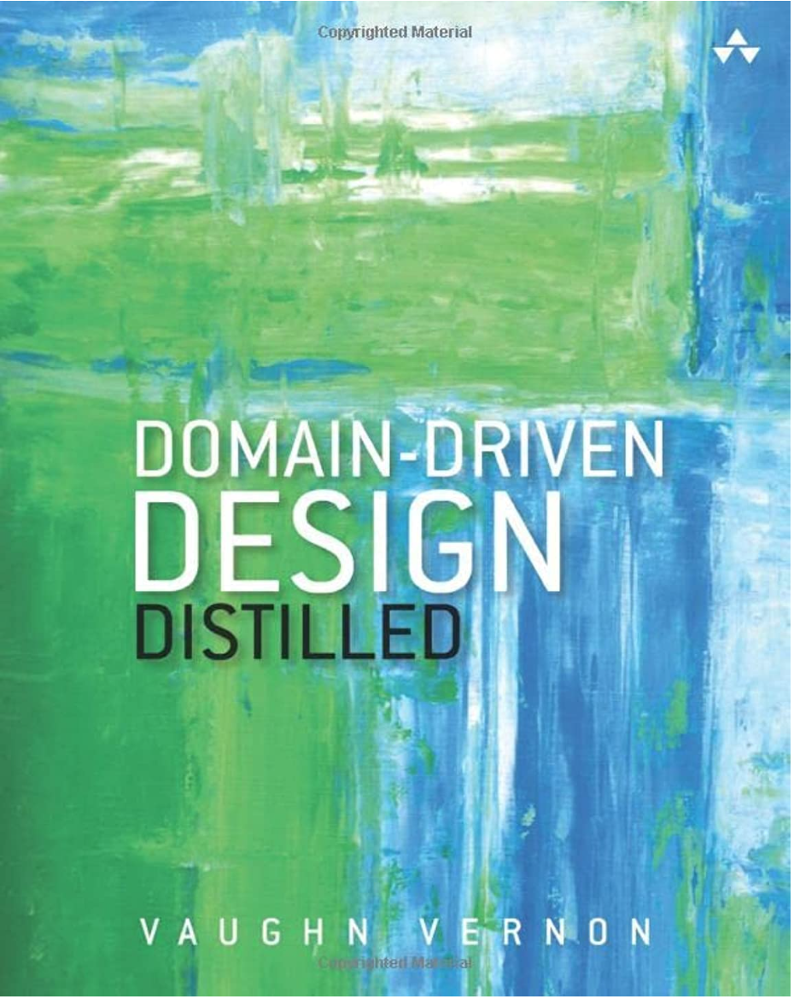
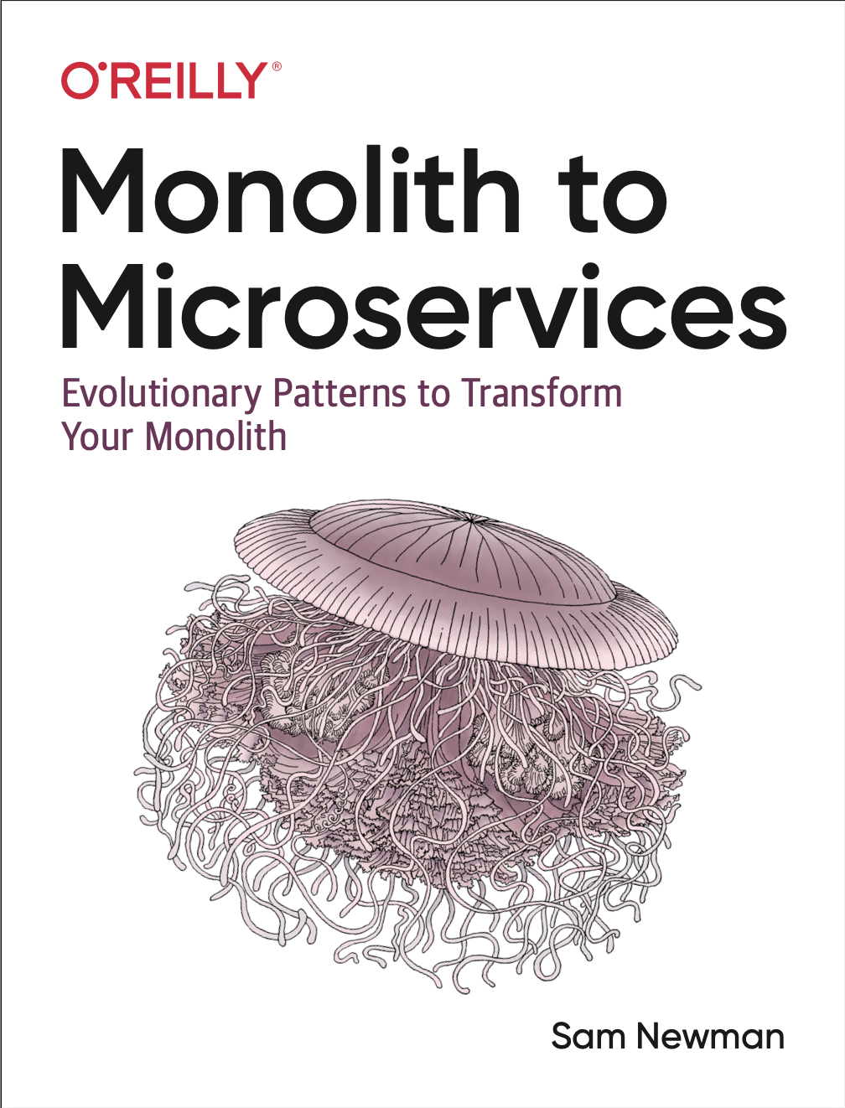
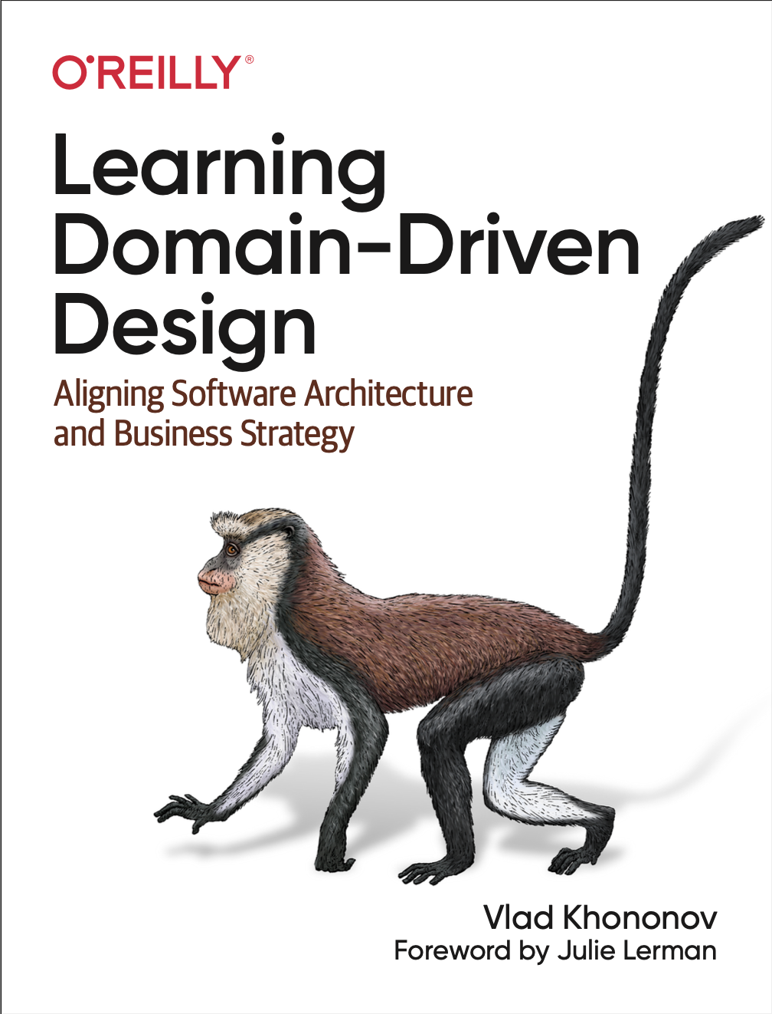
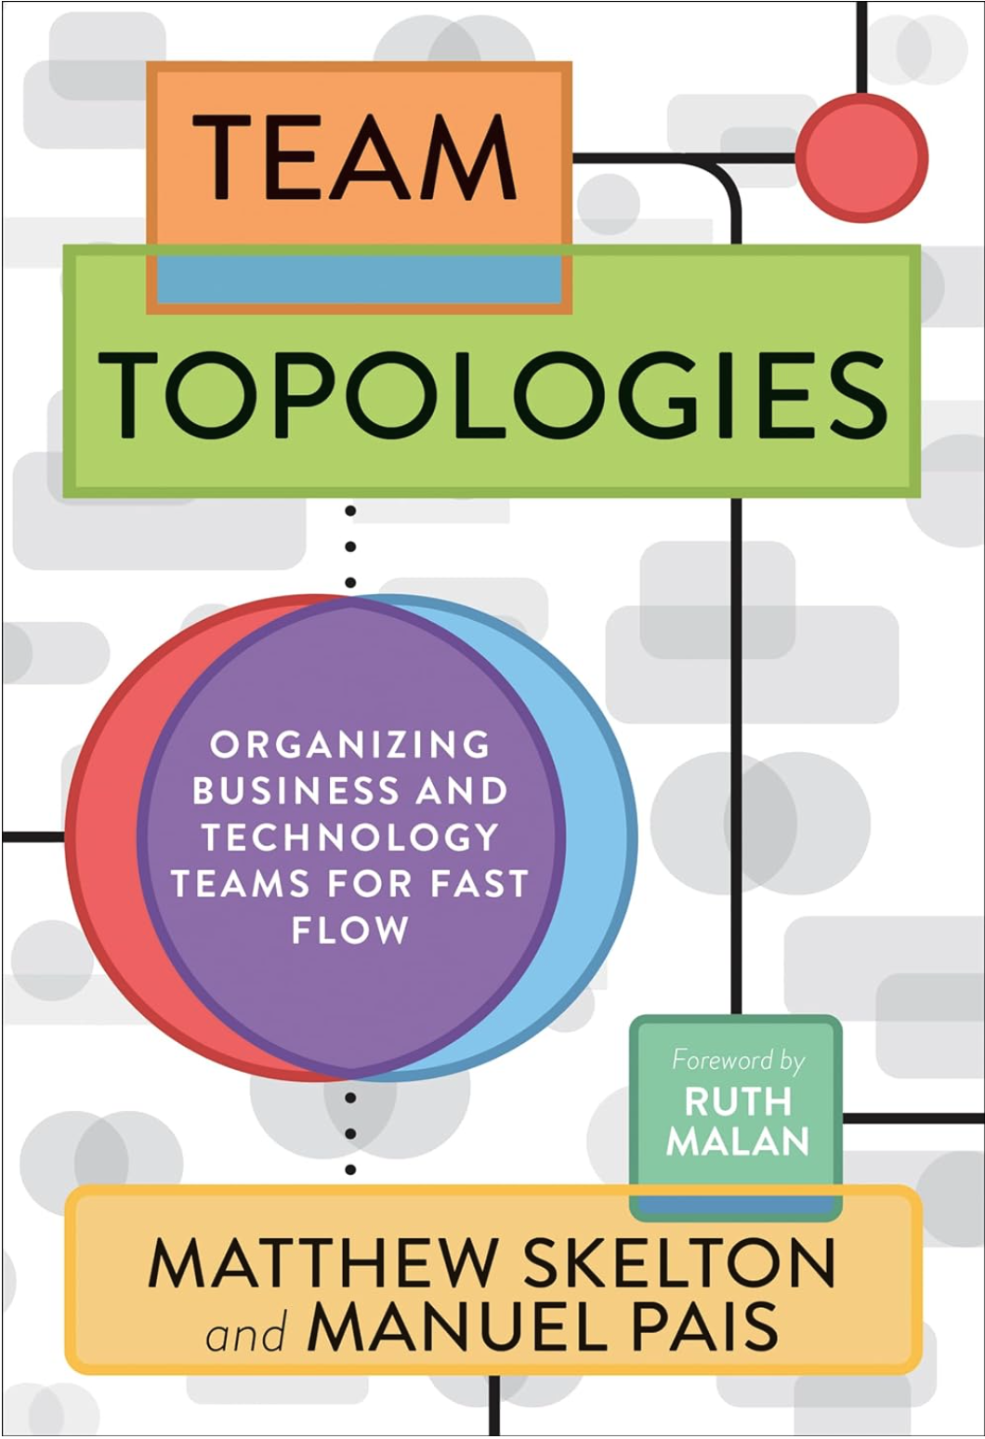
Useful book references …

Slide 16
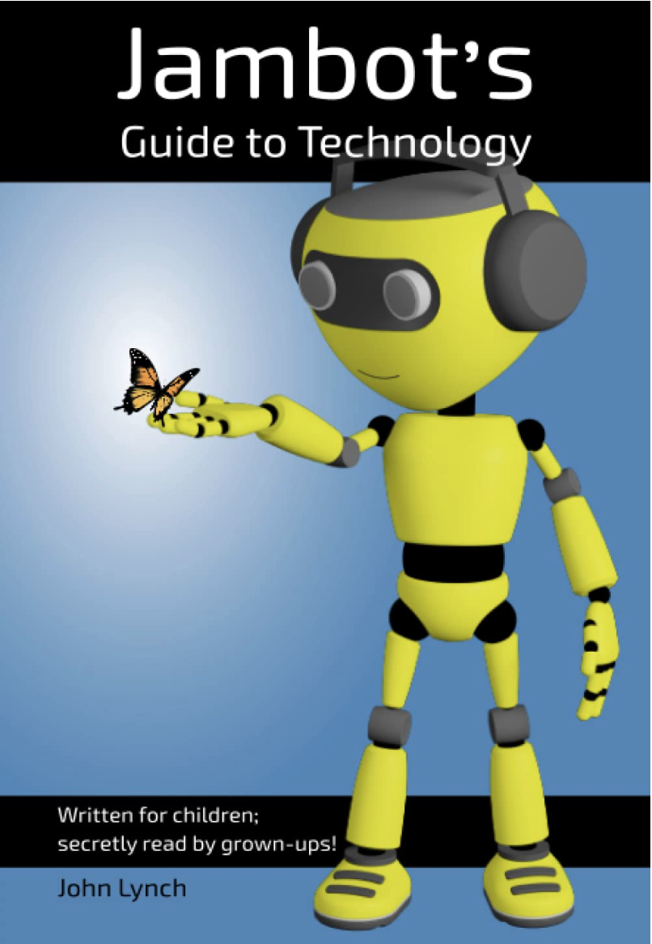
My contact details
Name: John Lynch Role: Senior Solutions Architect, Signify Health
LinkedIn: www.linkedin.com/in/john-lynch-b05182a
Author: Jambot’s Guide to Technology - written for children; secretly read by grown-ups!
Website: https://www.jambottech.com
LinkedIn: https://www.linkedin.com/in/jambottech-learning-hubs1/
Instagram: @jambottech

Slide 17
Questions?

Slide 18


SECURE CLOUD
Galway IT Meetup
Front-End Developer @ Zest Consulting
Safeguarding Your Data
Michael Dunne
July 18, 2024

Slide 19
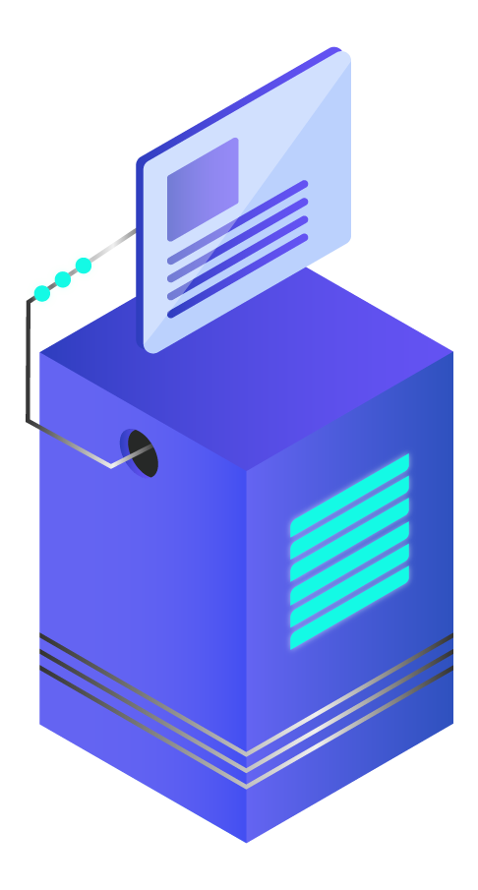
Introduction
Galway IT Meetup
Why Cloud Security Matters
Ya what?
DevSecOps
Best Practices
OWASP Threat Prevention
Developer Tools
ENISA Threat Landscape

Slide 20
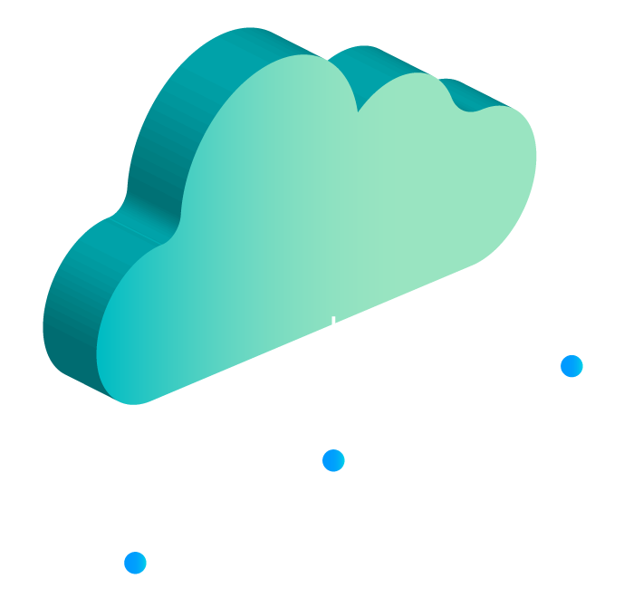
WHY CLOUD SECURITY MATTERS
Galway IT Meetup
Data Protection CIA
Compliance with Regulations
Ensures Business Continuity
Maintains Trust and Reputation
Notes:
Data Protection: Cloud security ensures that sensitive data stored in the cloud is protected from unauthorized access, breaches, and theft. This is essential for maintaining the confidentiality, integrity, and availability of data, which is critical for businesses, governments, and individuals.
Compliance and Regulatory Requirements: Many industries are subject to stringent regulatory requirements regarding data privacy and security, such as GDPR, HIPAA, and PCI-DSS. Cloud security helps organizations comply with these regulations, avoiding legal penalties and maintaining customer trust.
Business Continuity and Disaster Recovery: Effective cloud security measures ensure that data and applications are available even in the event of a cyberattack, natural disaster, or other disruptions. This helps organizations maintain business continuity and recover quickly from incidents, minimizing downtime and financial loss.
Reputation and Trust: Security breaches can significantly damage an organization's reputation and erode customer trust. By prioritizing cloud security, organizations demonstrate their commitment to protecting their customers' data, which can enhance their reputation and build long-term trust with clients and partners.

Slide 21

CORE PRINCIPLES OF CLOUD SECURITY
CIA TRIAD
Core Principles of Cloud Security
Core Principles of Cloud Security
Notes:
Confidentiality: only authorised to access data
Integrity: making sure documents are not tampered with
Availability: In the cloud, backups and redundancy keep your data available even if a server hiccups.

Slide 22


Breach 2013 & 2014
Spear Phishing Attack
3.5 Billion Records Exposed
Verizon Acquisition Lowered Price by 350 M
35M + in Fines
117.5M + in Lawsuits

Slide 23
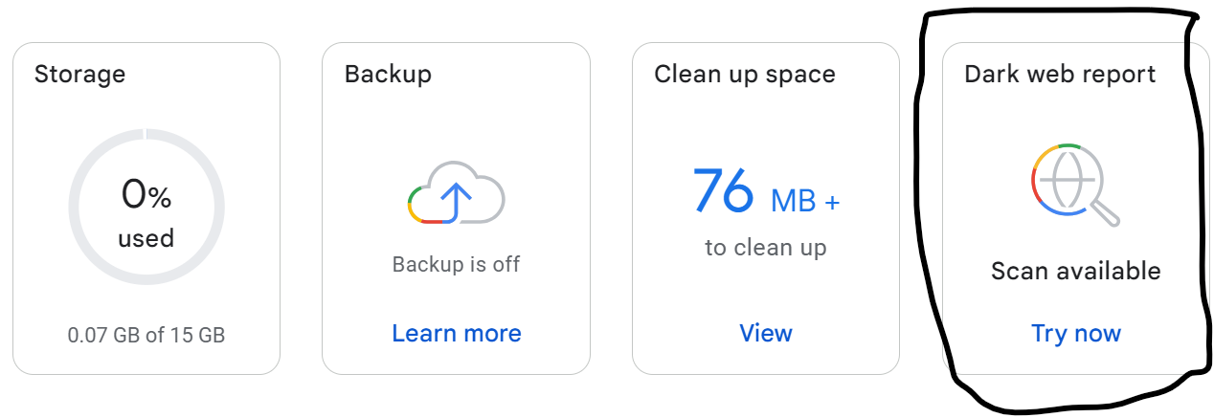
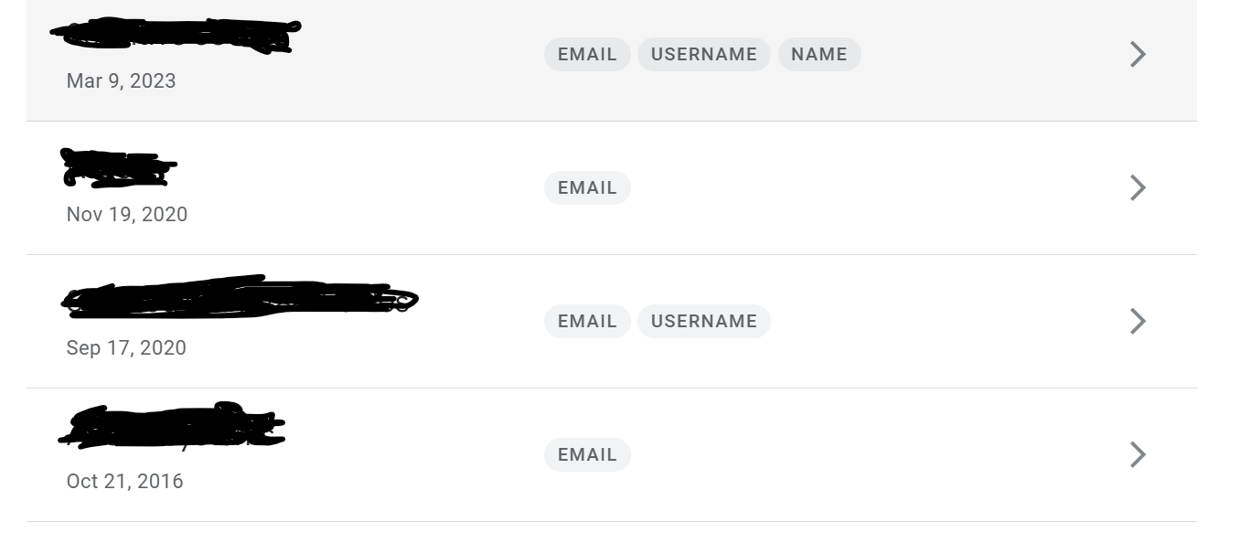
https://one.google.com/?g1_landing_page=1

Slide 24
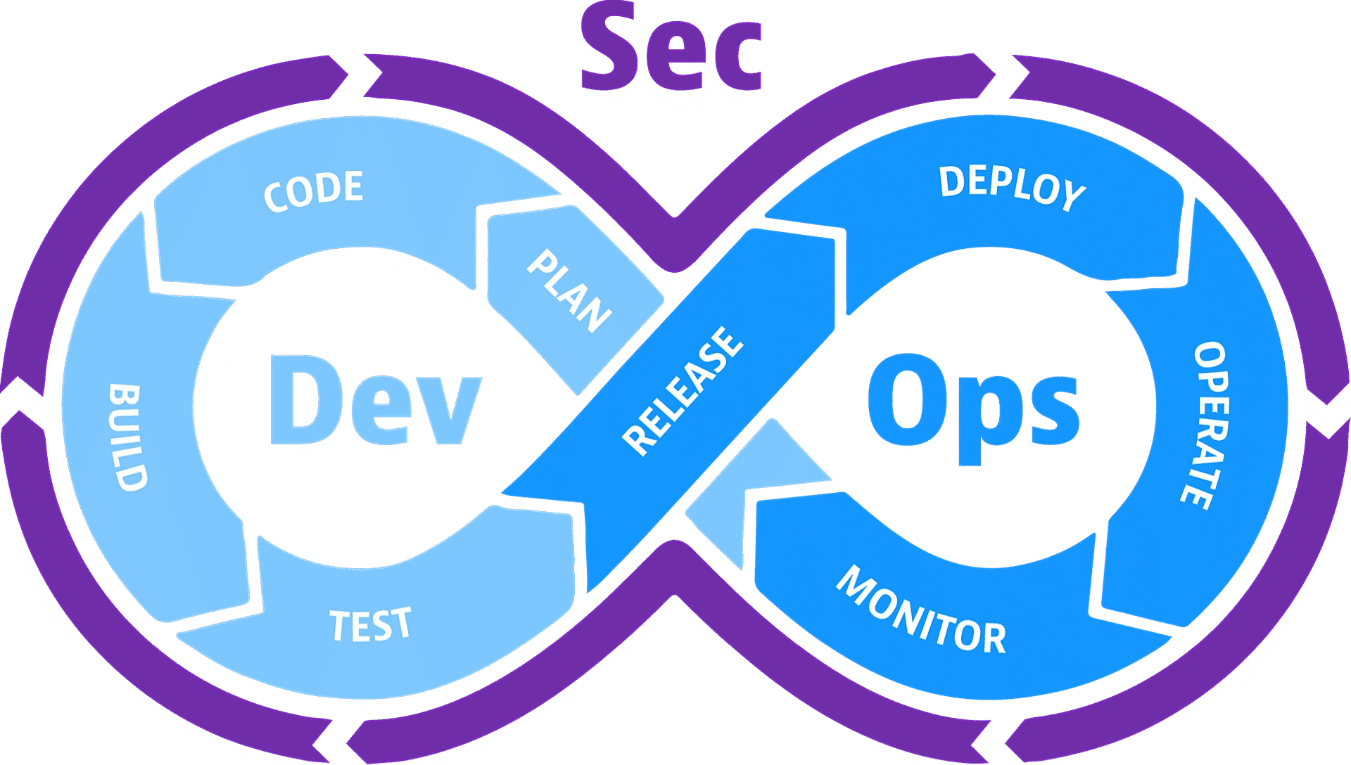
SOFTWARE DEVELOPMENT LIFECYCLE
Galway IT Meetup
Notes:
Identifies and fix vulnerabilities early in the development process.
Automates security testing and configuration management.
Deliver secure cloud applications faster and more efficiently.

Slide 25
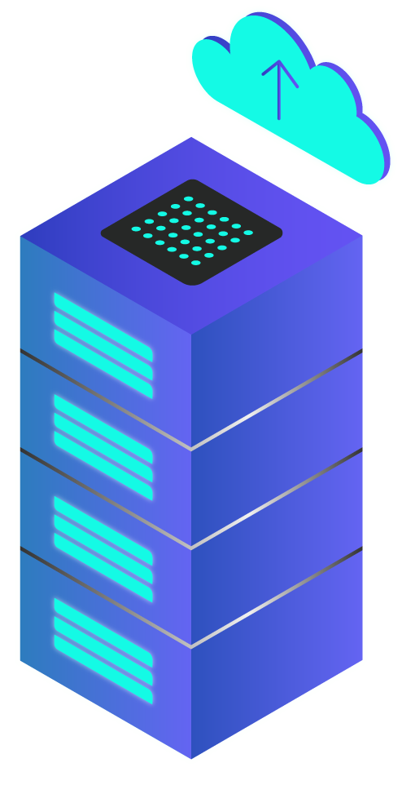
Secure Cloud
Best Practices
Galway IT Meetup
Identity & Access Mgmt
Data Encryption
Security Monitoring
Regular Backups
Notes:
Identity and Access Management (IAM) is a framework that ensures the right users have the appropriate access to an organization's resources. To ensure data security in the cloud, businesses can encrypt sensitive information before uploading it to cloud storage services.
Secure monitoring refers to the continuous process of tracking and analyzing activity within a system or network to identify and respond to security threats in real-time.

Slide 26

OWASP THREATS TO THE CLOUD
Security Misconfiguration
Broken Access Control
01
02
04
Identification and Authentication Failures
03
Vulnerable and Outdated Components
04
05
Injection
Notes:
Security Misconfiguration: This directly exposes vulnerabilities in cloud security because of improper setup or configuration of cloud services or resources.
Broken Access Control: This directly grants unauthorized access to cloud data and systems
Identification and Authentication Failures: Weak authentication methods or flaws in the identification process can lead to unauthorized access to cloud resources.
Vulnerable and Outdated Components: Using software with known vulnerabilities within the cloud environment creates a direct entry point for attackers.
Injection: This can be a direct threat if it allows attackers to inject malicious code into cloud applications or services.
AWS Shield
Azure
Google Cloud Platform : get security suggestions/solutions for these 3.

Slide 27




Top Security Concerns for Developers
Galway IT Meetup
OWASP Top 10
CVE Tools
Continuous Monitoring
Notes:
CVE tools scan for known vulnerabilities in your software by referencing the Common Vulnerabilities and Exposures (CVE) list. The CVE list is a dictionary of publicly known security flaws, and CVE tools check your code or system against this list to identify potential weaknesses.
Continuous Monitoring: Continuous monitoring empowers developers to proactively detect and address security issues in their applications.

Slide 28
Top Security Tools for Developers
Galway IT Meetup
OWASP ZAP VS
OWASP - Nessus Professional VS
CVE website
OpenCVE
Continuous Monitoring - Splunk
Cloudflare WAF
Imperva WAF
Notes:
OWASP ZAP (Zed Attack Proxy): https://www.zaproxy.org/ (Open Source) A comprehensive vulnerability scanner that can identify a wide range of vulnerabilities, including those related to OWASP threats.OWASP ZAP (Zed Attack Proxy): https://www.zaproxy.org/ (Open Source)
OWASP - Nessus Professional: https://www.tenable.com/products/nessus/nessus-professional (Commercial)
zap for web applications and nessus for networks and multiple apps
CVE Tools: This refers to the "Common Vulnerabilities and Exposures" list, a database of publicly known software vulnerabilities.
CVE website (https://cve.org/).
OpenCVE (https://www.opencve.io/): This platform allows you to track CVE updates, search the CVE database, and receive alerts about vulnerabilities affecting specific vendors or products. Continuous Monitoring Tools:
They analyze this data to identify suspicious activity, potential threats, and security incidents. Some popular tools include:
Splunk (https://www.splunk.com/)
These tools focus on specific security aspects:
Web Application Firewalls (WAFs): These monitor web traffic for malicious activity like SQL injection attacks and cross-site scripting (XSS). Examples include:
Cloudflare WAF (https://developers.cloudflare.com/waf/)
Imperva WAF (https://www.imperva.com/)

Slide 29
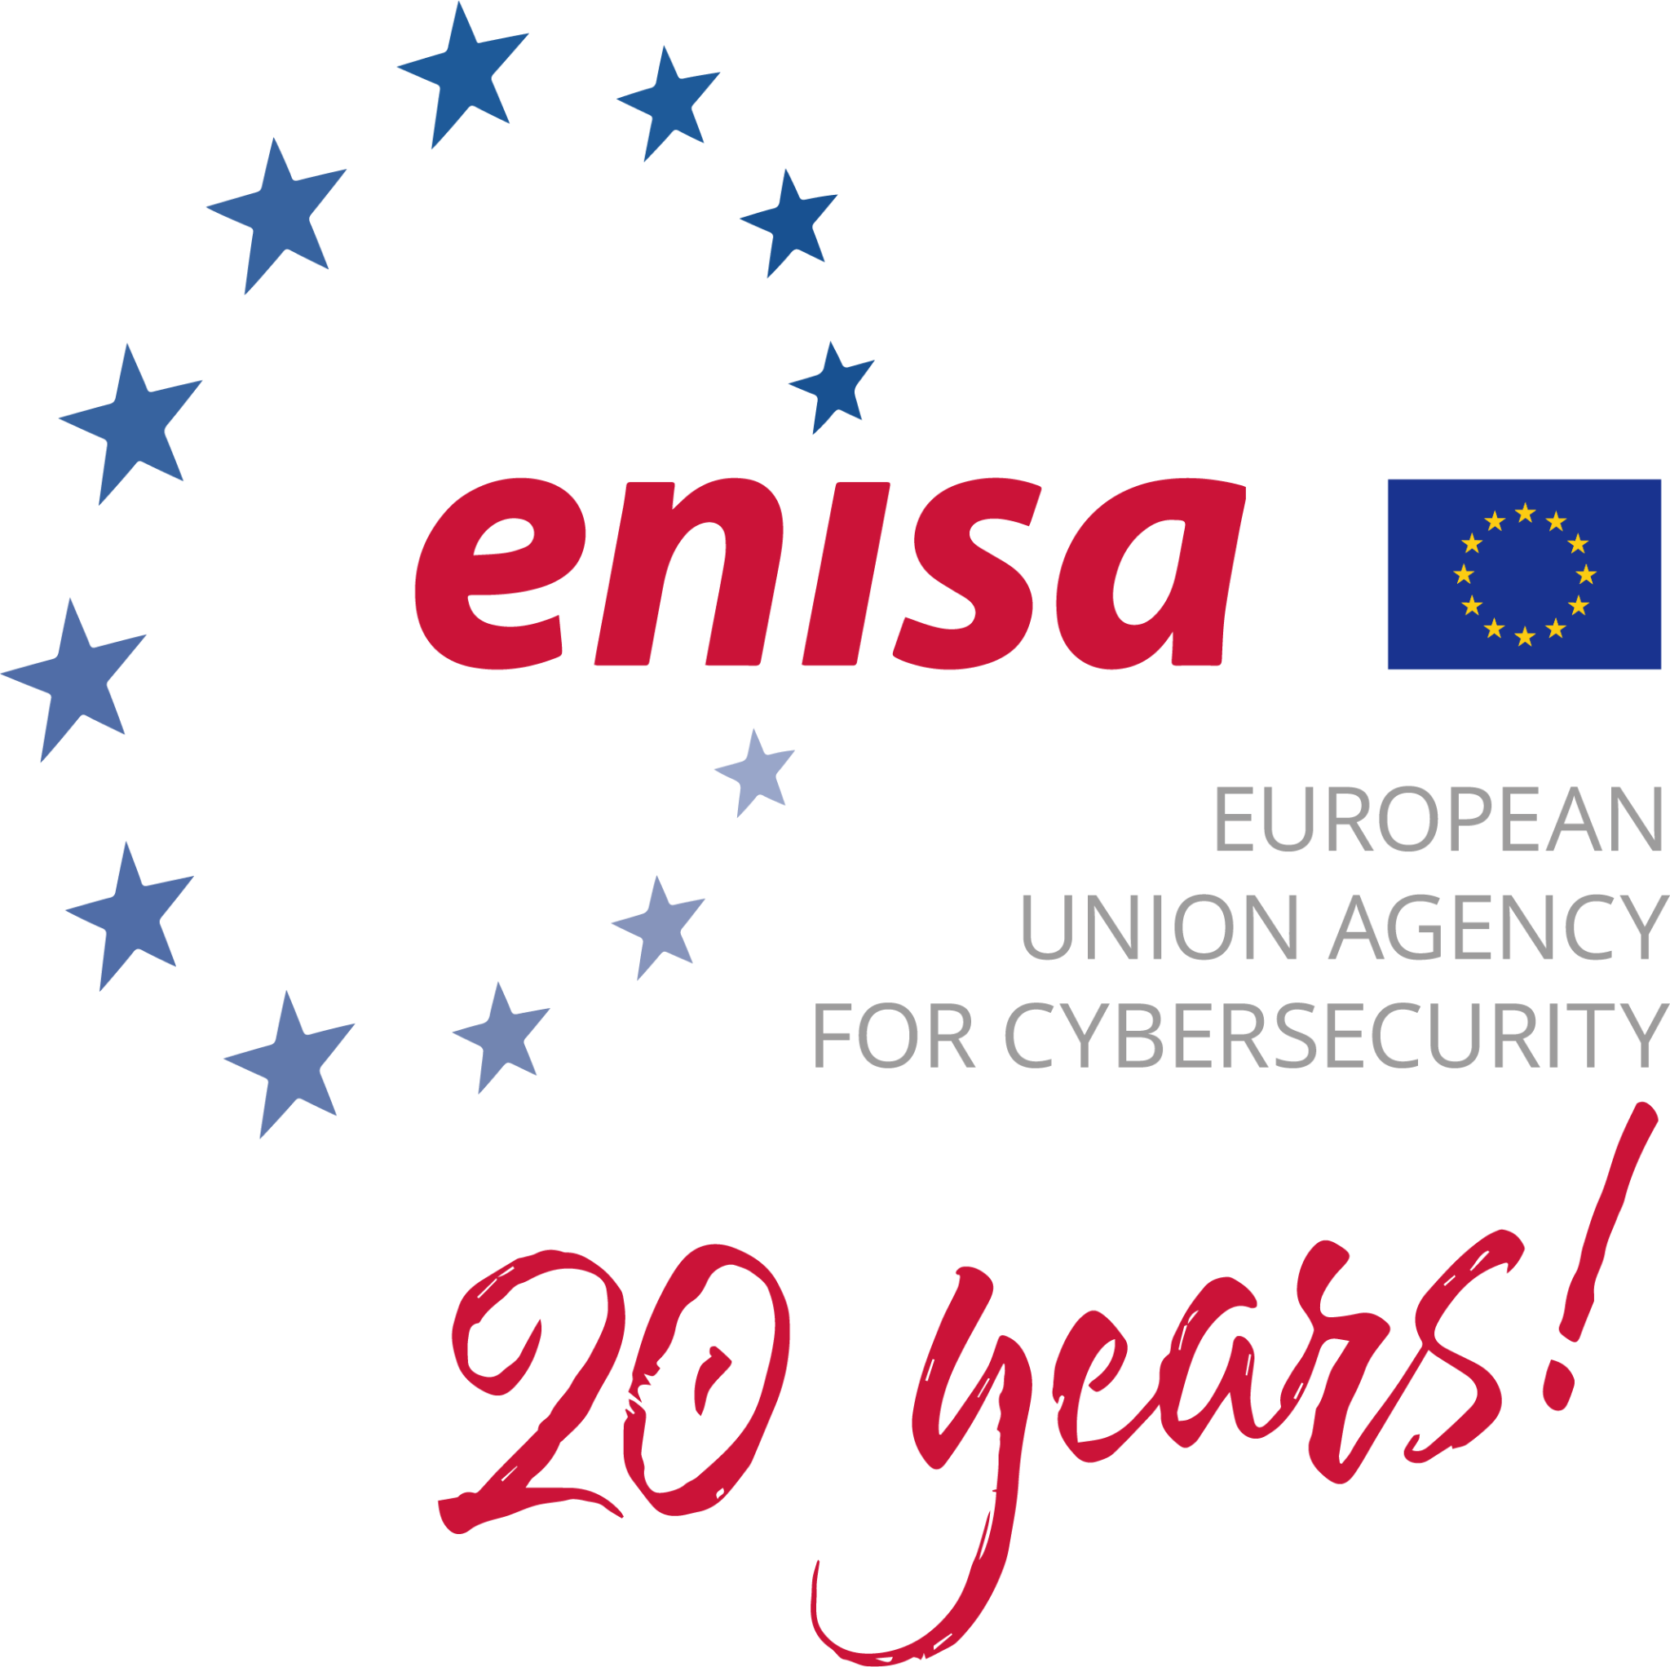
ENISA Threats for 2030
Fu
Galway IT Meetup
Abuse of AI
Ransomware Targeting Development Tools and Environments
Skill Shortage in Cybersecurity
Notes:
Abuse of AI: As Artificial Intelligence (AI) becomes more powerful, there's a risk that malicious actors will use it for harmful purposes. Ransomware Targeting Development Tools and Environments: Ransomware attacks that specifically target development tools and environments could become more common. This could lead to stolen source code, disrupted development workflows, and even the deployment of malicious code. Developers will need to be aware of these risks and implement strong security measures to protect their development environments. Skill Shortage in Cybersecurity: The demand for cybersecurity professionals is rapidly growing, and there may not be enough qualified people to fill all the positions. This means developers will need to take on more security responsibility within their roles.

Slide 30

YOUR TAKEAWAY
Galway IT Meetup
DevSecOps
Best Practices
OWASP Threats
Developer Tools
ENISA Threat Landscape

Slide 31
Refrences
Galway IT Meetup
OWASP ZAP (Zed Attack Proxy)
GoogleOne
OWASP - Nessus Professional
ENISA
CVE.org
Data Protection Commission
intel/cve-bin-tool
CIA Triad
OpenCVE
Shared Responsibility Model
Continuous Monitoring - Splunk
OWASP
ELK Stack
DevSecOps
Cloudflare WAF
Imperva WAF

Slide 32

Galway IT Meetup
Effortless Development with Google Project IDX
Tom Prior
Staff Engineer
July 18, 2024
Notes:
I would like to talk to you about IAM: Identity Access Management
I’ll give you a brief overview, a history of how we got here, problems I have with IAM systems and some solutions to those problems.
And I should add - I’m by no means an expert on this. This isn’t as much a talk by a subject matter expert as a commiseration at a complicated technology foisted upon us.

Slide 33

Galway IT Meetup
IAM: Inane Access Management
Manageable Identity Access Management for Cloud Providers
Liam Krewer
Senior Software Engineer @ FleetOps
July 18, 2024
Notes:
I would like to talk to you about IAM: Identity Access Management
I’ll give you a brief overview, a history of how we got here, problems I have with IAM systems and some solutions to those problems.
And I should add - I’m by no means an expert on this. This isn’t as much a talk by a subject matter expert as a commiseration at a complicated technology foisted upon us.

Slide 34
Identity Access Management
What is it?
Notes:
Identity Access Management is the management of authentication and authorization.
Authentication is proving you are who you claim to be. Typically this would be by username and password, certificate, API KEY or key pair.
Once you are authenticated, authorization specifies what parts of a system you can access and/or modify. Typically these rules would be set by a service owner or administrator.
This is a core concept across all kinds of software. Has anyone here ever written or worked on an IAM system?

Slide 35
A brief History of IAM
1961 CTSS (Compatible Time Sharing System)
1988 Kerberos
1993 LDAP (Lightweight Directory Access Protocol)
1999 Active Directory
2011 AWS IAM
Notes:
So that’s a lot of heavy lifting done by three little letters.
Let’s see how it got there via a very abridged history:
MIT first implemented a type of IAM system called Compatible Time-Sharing System in 1961
The idea was that a powerful computer, like the IBM 7090 (with an impressive 100Kflops) could be used simultaneously by multiple users and programs.
In 1988, Kerberos was introduced - an encrypted authentication protocol using a third party key distribution service.
1993 LDAP Lightweight Directory Access Protocol used for authorization and access management to various services (email, printing, data storage etc.).
1999 Windows Active Directory: LDAP implementation for managing windows computers and servers
2002 AWS launched
2011 AWS IAM launched

Slide 36
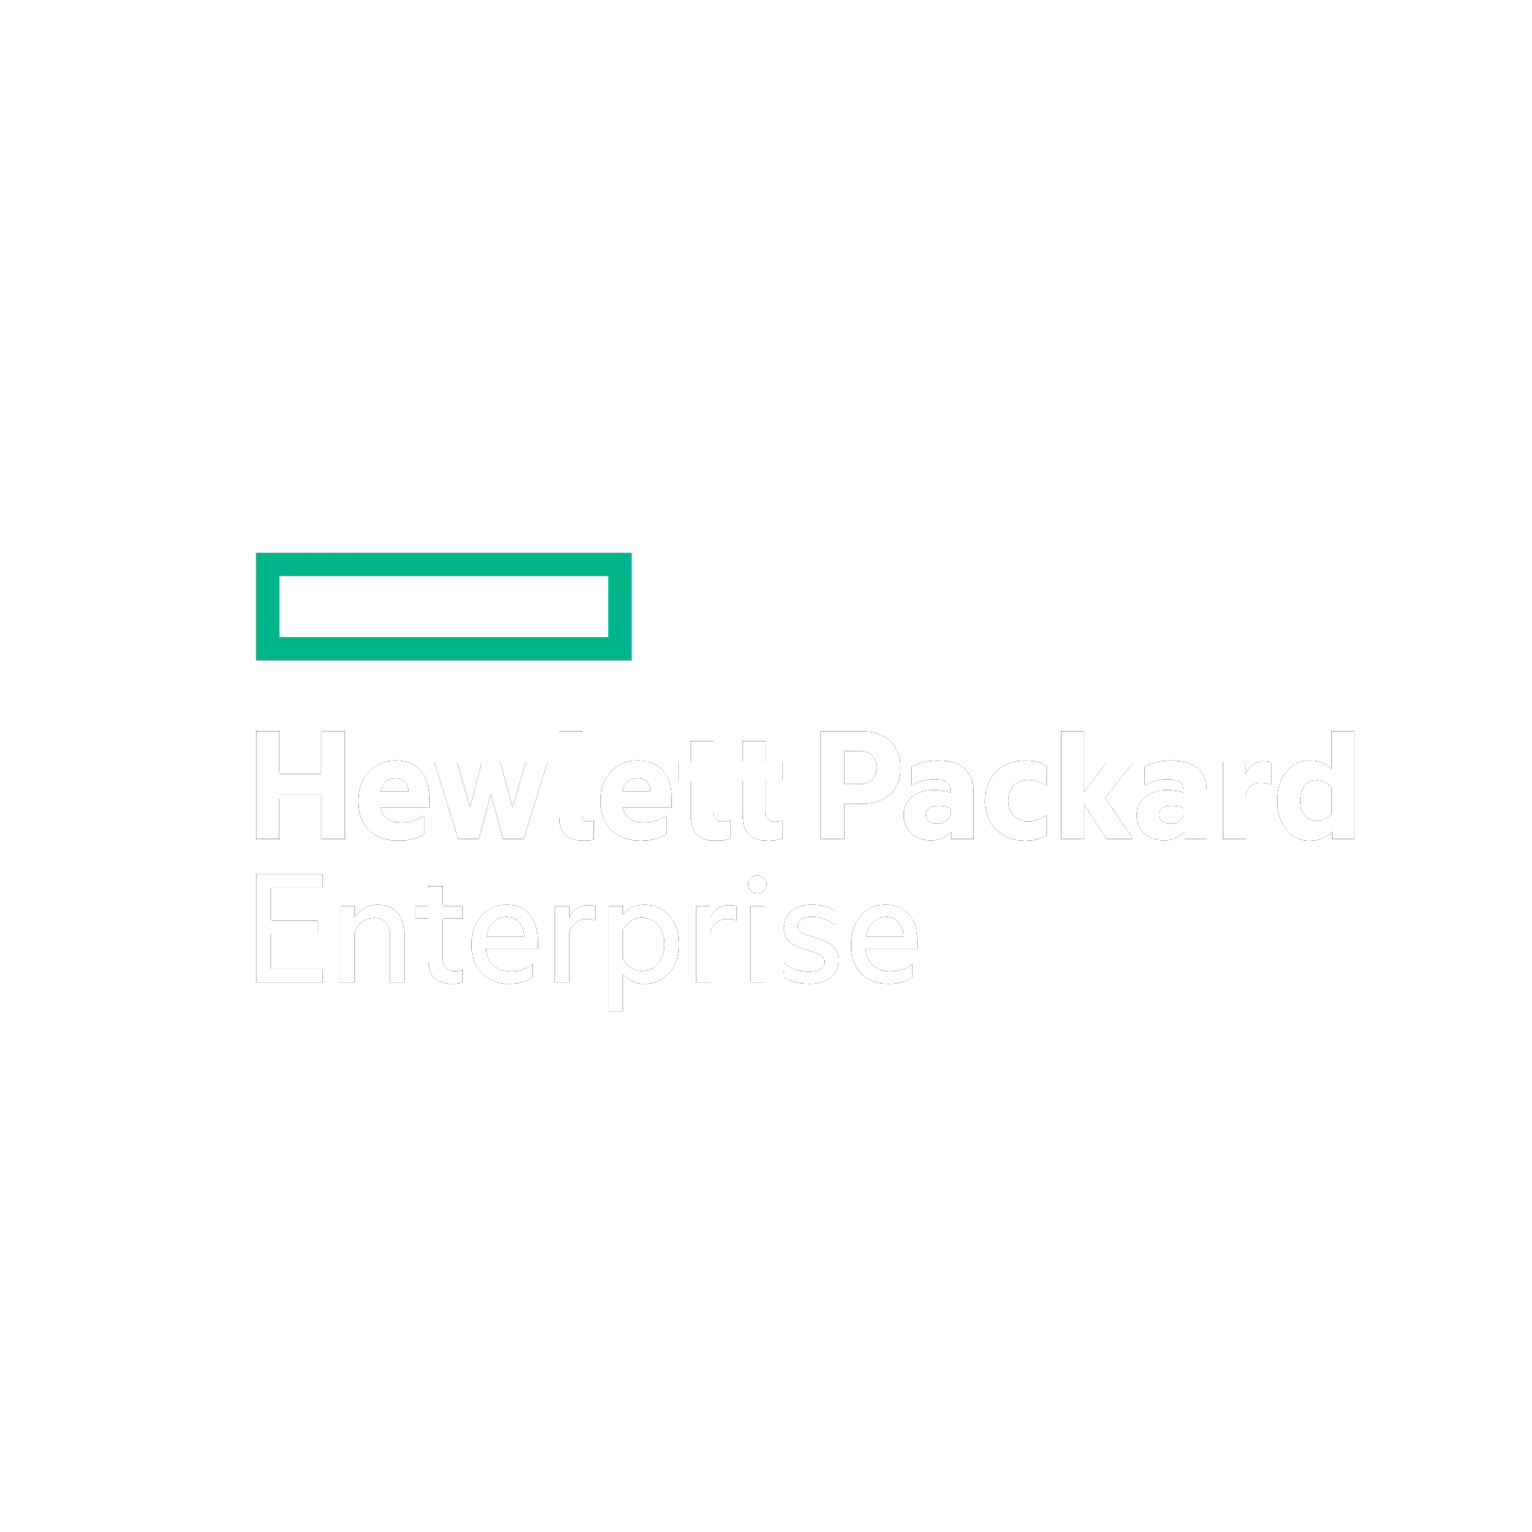
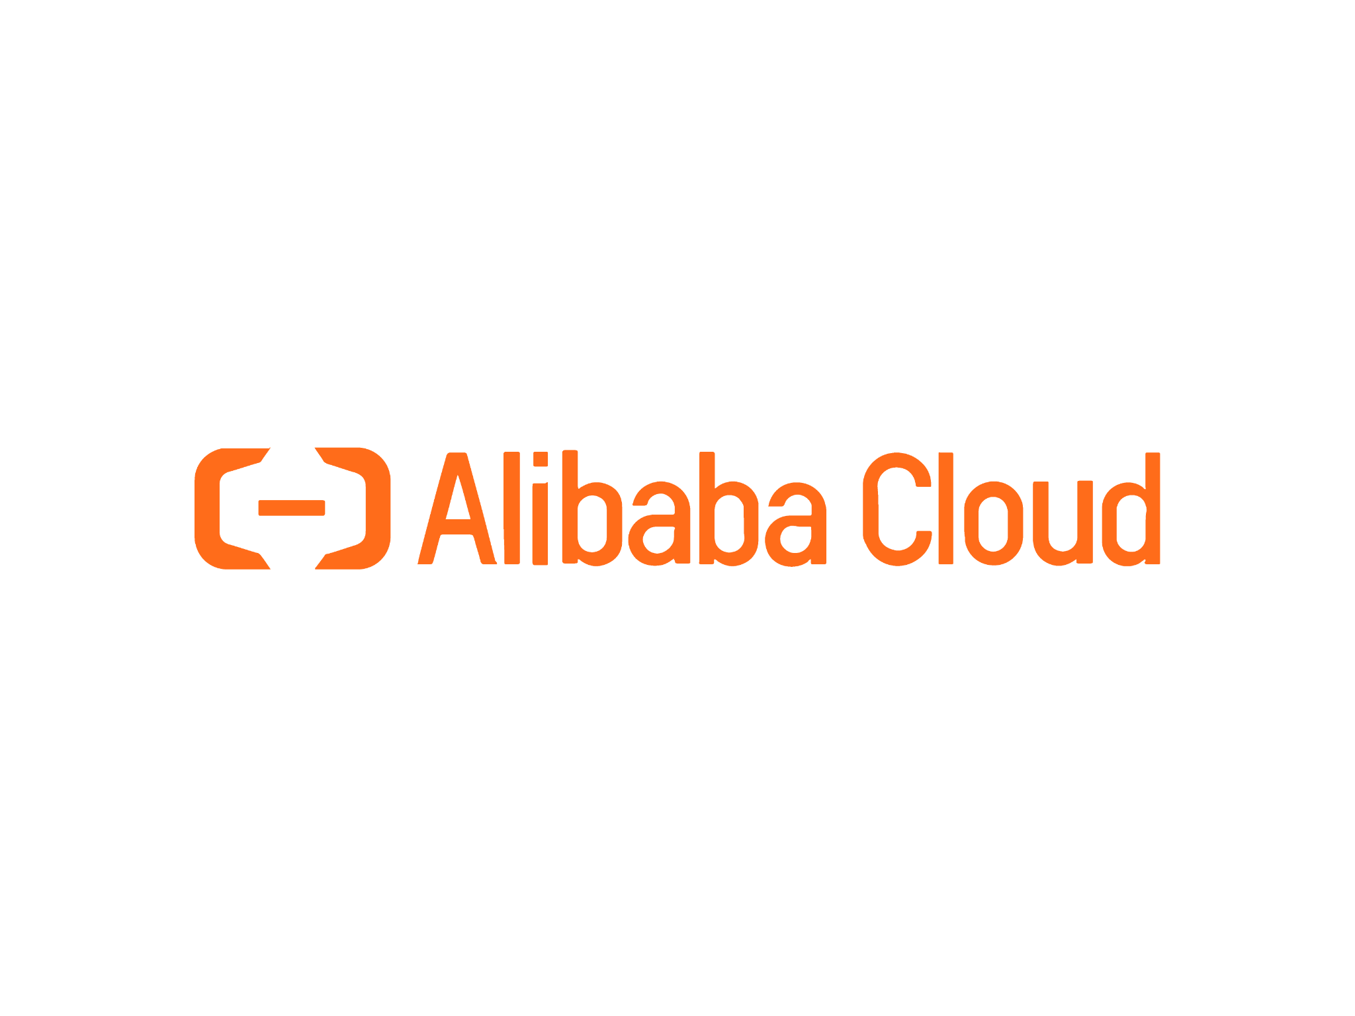
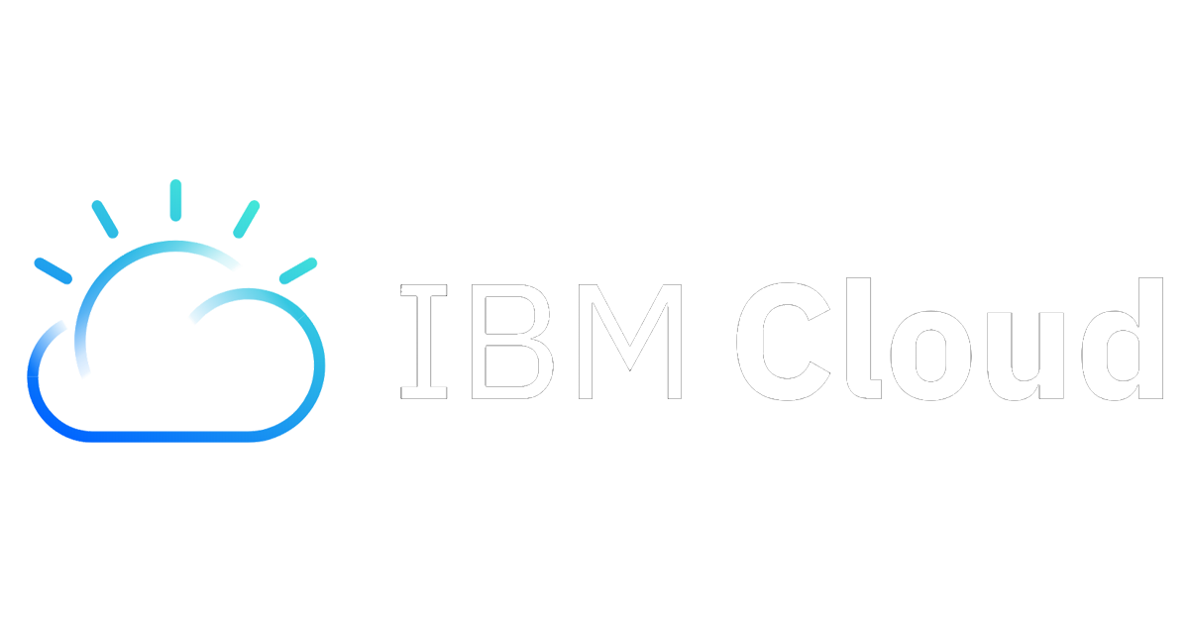
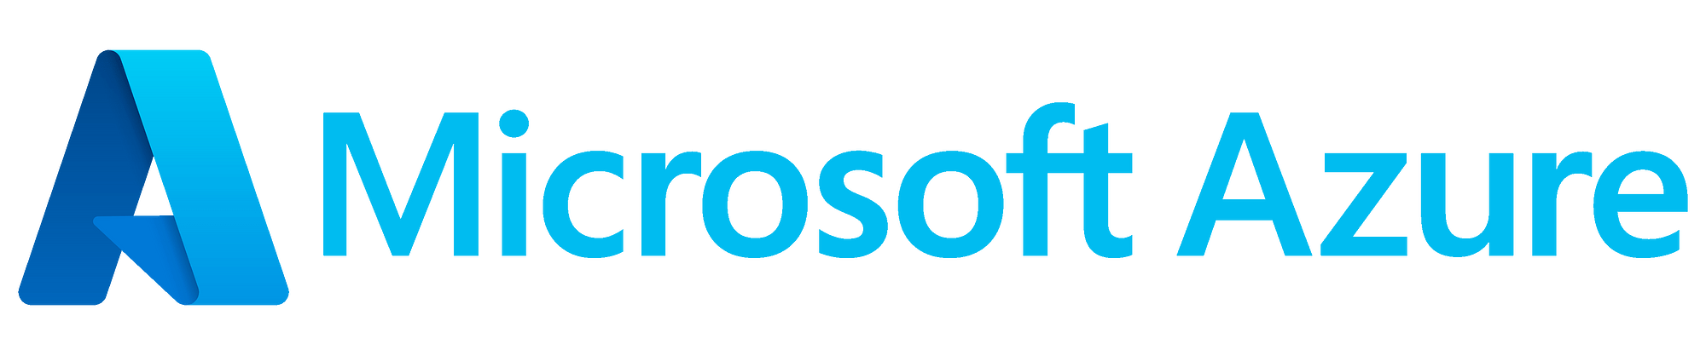
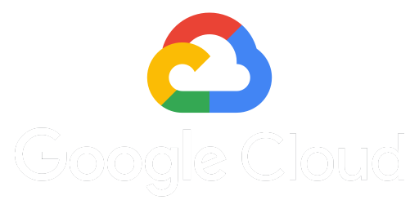
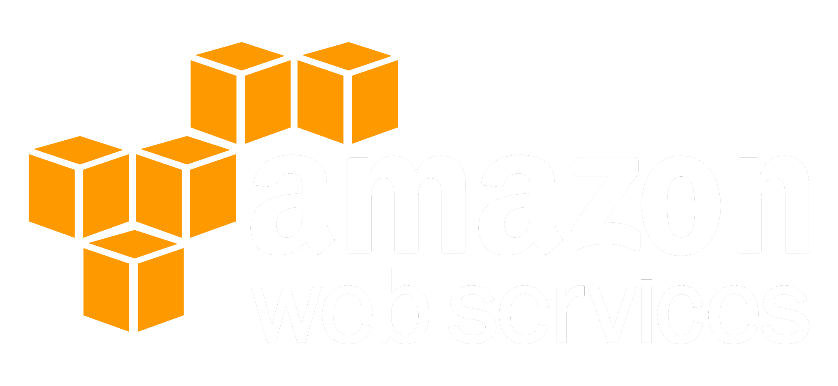
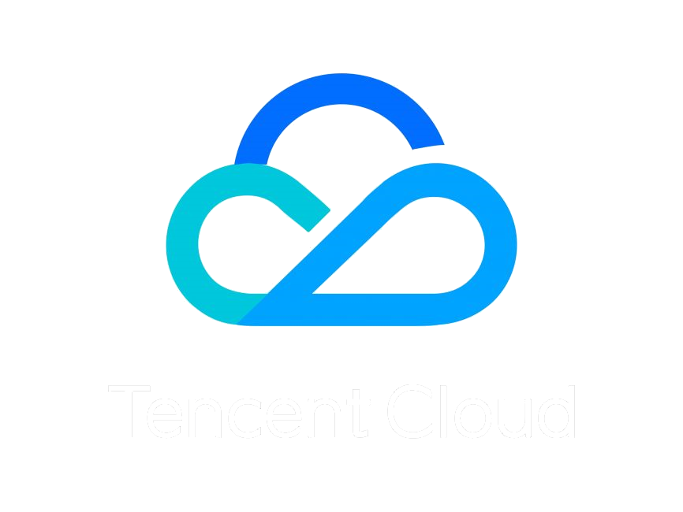
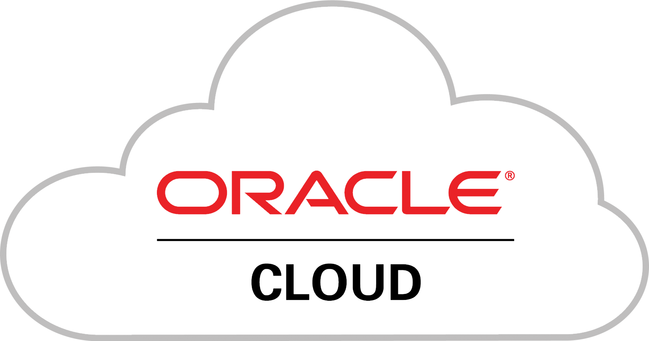
IAM in Cloud Services
Notes:
But today we are talking about Cloud Computing, so let’s see what IAM looks like in Cloud Providers
All of these provide some form of IAM, though Alibaba calls it IDaaS, Tencent has Cloud Access Management, and Microsoft has branded it Entra
Questions
Who in the room has used any of these cloud providers?
Who has used their IAM tools?
Does anyone like using it?

Slide 37
Core Concepts
Users
Authentication
Authorization
Management
Notes:
The core concepts of IAM in cloud providers are the same as elsewhere.
Create a set of users who can use the service.
Create secure authentication for them, either passwords or API keys depending on the type of access.
Authorize them to be allowed to use specific services, like networking, compute, databases, storage, queues etc.
And even elevate some users to admins who can manage the access of themselves and other users as requirements change over time, or even as new services as offered.

Slide 38
But wait, there’s more
Service Accounts
Roles
Groups
Tagging
Identity
Time
Users
Access Perimeters
Resources
Temporary Tokens
Resources
Network
Actions
Conditions
Federation
Permissions
Access Levels
Dependant Actions
Notes:
Unfortunately, it’s not that simple.
For starters, it’s called IAM. An identity doesn’t have to be a user. They can be groups, roles, service accounts, resources and even federated users provided by a different system altogether. Initially only users and groups existed, the rest were added over time.
Then we come to the type of permissions we can grant to a user. We don’t to make every user who needs access to a database a database administrator.
Instead we have fine grained permission actions defining what you can do, like reading from a specific table.
These are collected into policies of commonly combined permissions. Because if I want to read from a table, I probably also want to read from the index.
You can also form your own specific policies to assign to an identity.
But having permission to read that table doesn’t mean you can definitely access it. You can also be limited by perimeters, such as resource, network, time or even identity. So only this set of compute units from this network range on a Tuesday morning can access the database.
Or you can reverse the process and apply permissions to the resource you are trying to access, rather than the identity trying to access.

Slide 39
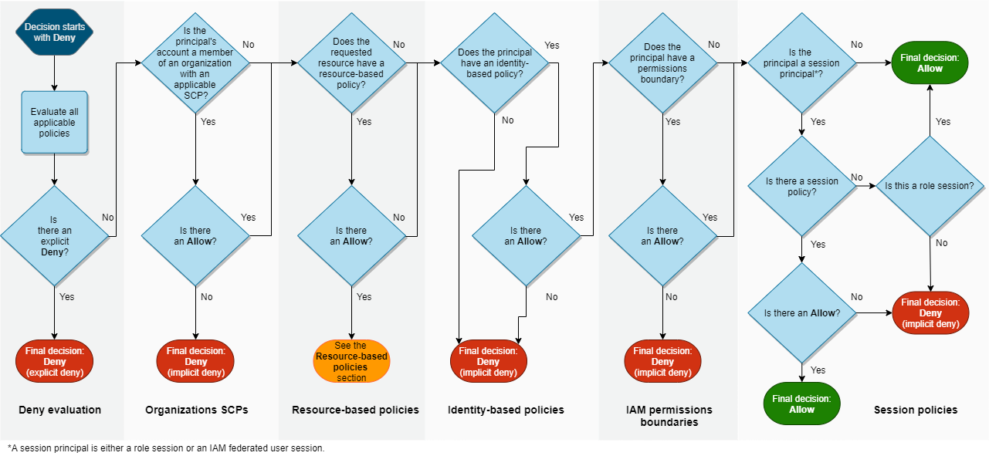
SOURCE: https://docs.aws.amazon.com/IAM/latest/UserGuide/reference_policies_evaluation-logic.html#policy-eval-denyallow
Notes:
I admit that word cloud was a little complicated, but here’s AWS’s flow chart of checking if you are allowed to do something.
There are a lot of ways of trying to accomplish the same thing, and if things are misconfigured, you have a lot of places to check why you don’t have access.
This is because all of these gigantic cloud services have grown over time, and their IAM services have been extended and patched as needed.
Like any other software, the developers weren’t handed a fully formed specification with all future requirements known.

Slide 40
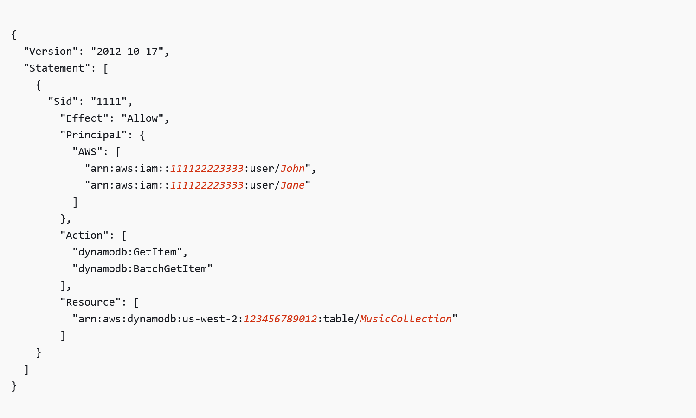
Example AWS Policy
SOURCE: https://docs.aws.amazon.com/amazondynamodb/latest/developerguide/rbac-examples.html
Notes:
Let’s continue using AWS as an example.
Together all of these grains of access management form IAM policies
Because it’s all cobbled together over time, we start with a version number.
Then the Access Statement is given an id, and we decide whether we are allowing, or denying access based on these rules.
The principal is the identity whom we are granting access. In AWS’s case they are identified by your account id and a name.
Next we define the actions they can use, and finally the resource on which they can execute these actions.
Pretty straightforward, right?
So why am I so upset with IAM?

Slide 41
Complexity
Cloud | Actions | API Methods
AWS | 17,034 | 15,427
Azure | 18,993 | 17,090
GCP | 10,053 | 11,912
SOURCE: https://aws.permissions.cloud/
Notes:
Because that example was the equivalent of a ToDo demo application, though one where you cannot even write your own ToDos, only view what someone else provided.
Cloud Provider’s today have THOUSANDS of actions, each of which you need to grant permission to each identity which needs to use it.
This is amazing, from a security perspective.
But it’s horrible for a developer who just wants to get things done. It’s a roadblock, a headache.
Something I’d rather not be doing, which means I’ll make mistakes, which could cause a massive security breach.
Such as the Capital One breach, where excessive permissions attached to an EC2 instance running a firewall! (ModSecurity)

Slide 42
Frustrations
AWS Inline Policy limits: 10 policies per user or 2048 characters
Dependant Actions: Need read access for both table and index
Very broad Managed Policies
Many ways to achieve the same result:
Allow Many, Deny Some or vice versa?
Identity / Resource / Permission Boundary / SCP
Cross Account policies
Difficult to debug
Notes:
So IAM in the cloud is complicated by it’s sheer size, power and granularity.
But there are some aggravating details which have annoyed me in the past.
In AWS, policies have size limits, and they are very attainable. This means I have to split them up, rearrange them, use many roles and groups. This is a good thing, as it encourages encapsulation. But I don’t have a team of people to review and refactor policies, so it frustrates me personally.
One API call can hit many actions. Listing items from a database needs read access to both the index and storage. Decrypting secure keys needs access to the secret, the keystore and the decryption mechanism
To simplify all of this, AWS, GCP etc. offer premade policies for common operations, but they are of course broader than needed (otherwise they wouldn’t work).
Because the system has been built up over time there are many ways to achieve the same outcome. I still don’t know the “correct way”, though assume it changes for every usecase.
This flexibility makes it difficult to debug when you do get the dreaded 403 unauthorized access error.

Slide 43
(breathe)
Notes:
(deep breath)
So I’ve been rambling a lot about my frustrations with IAM.
Let’s move on to finding some solutions and making our lives easier.

Slide 44
Tools to help
Notes:
There is of course no silver bullet to help with IAM.
But there are some tools, both by the cloud providers and third parties to make things easier.

Slide 45
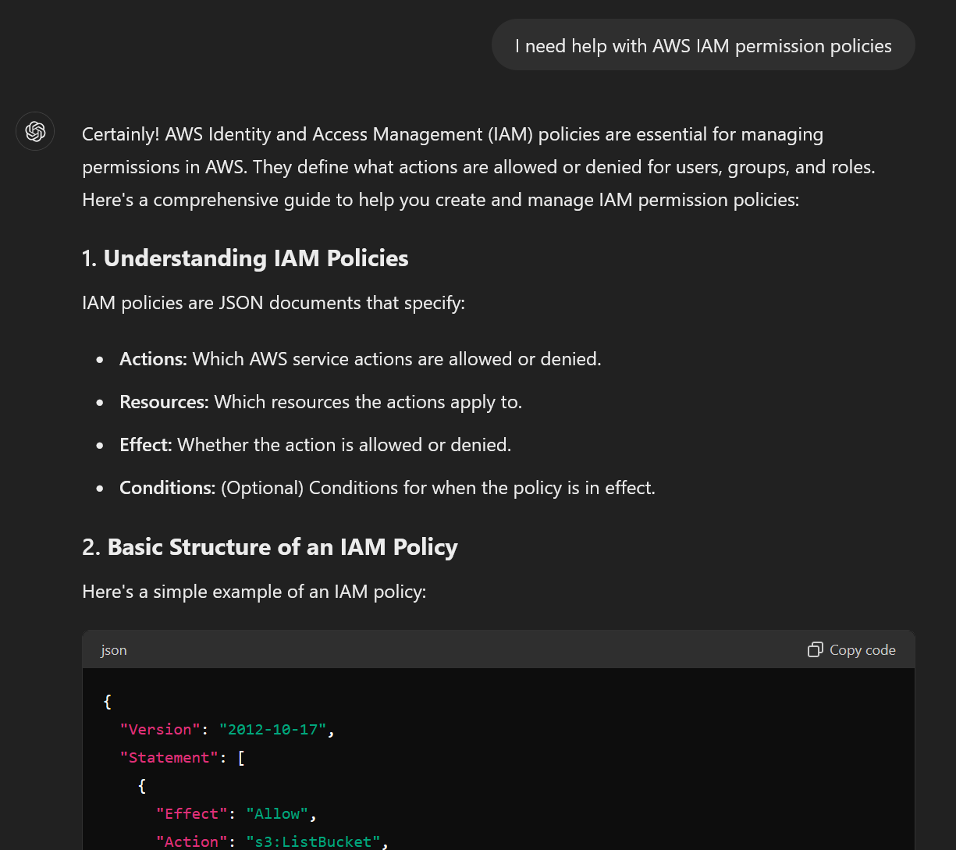
Chat GPT
SOURCE: https://chatgpt.com/
Notes:
I believe that IAM is not an insurmountable problem.
Just that I don’t have the time, energy nor inclination to master it.
But there’s this new tool, I don’t know if you’ve heard of it:
AI can help understand problems, disseminate information and even build JSON policy documents!
Just remember they aren’t infallible. Trust, but verify.

Slide 46
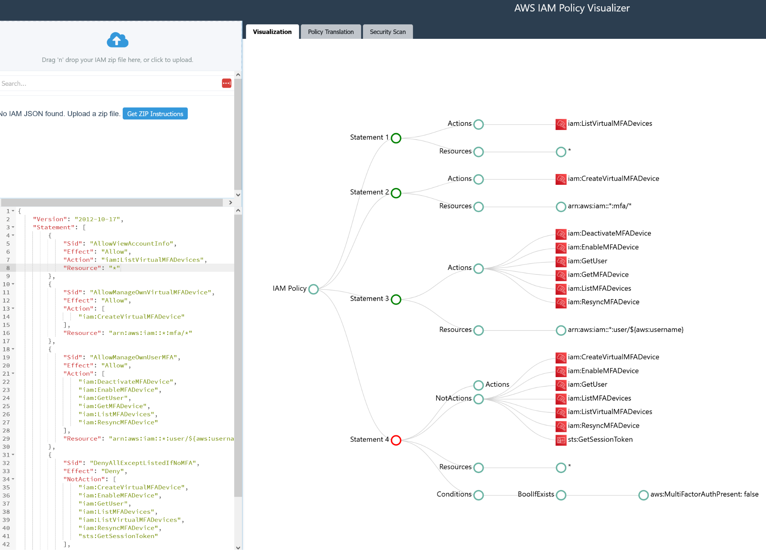
AWSVIZ.DEV
SOURCE: https://www.awsviz.dev/
Notes:
Here is a tool that should help verifying ChatGPT policies.
AWS VIZ will validate your JSON policy and give you a nice visualization so you can see what permissions are being granted on which resources.

Slide 47
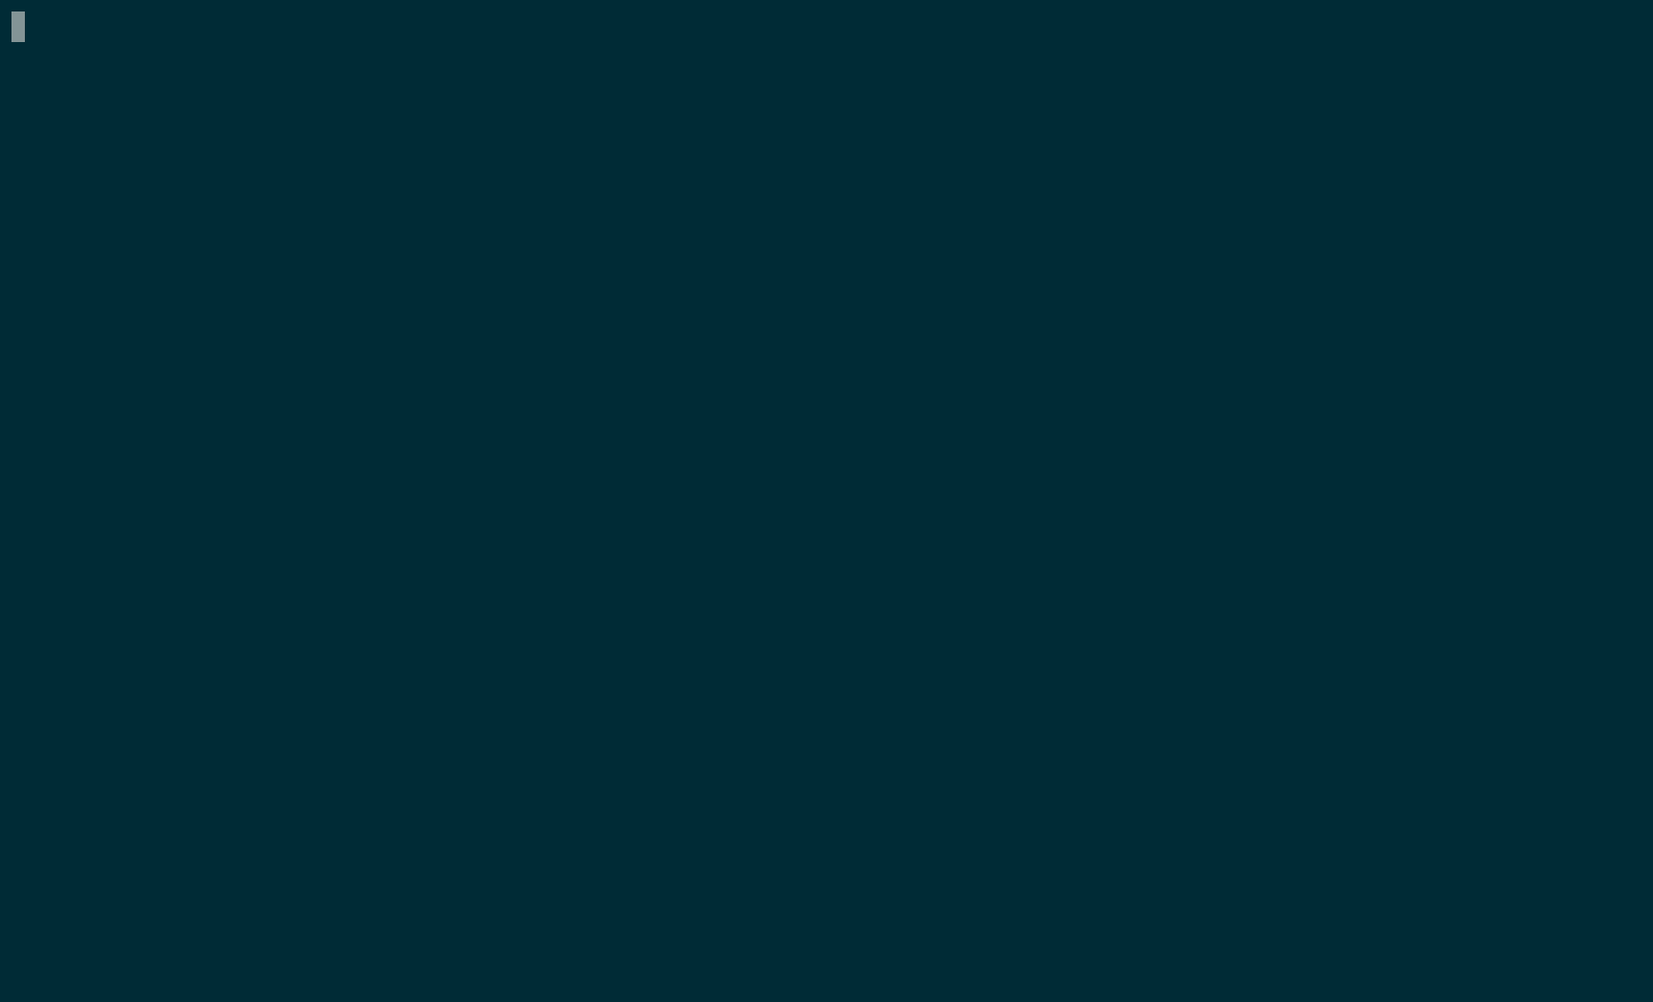
Policy Sentry
SOURCE: https://github.com/salesforce/policy_sentry/
Notes:
Policy Sentry is a command line tool for all you VIM / EMACS purists. It will generate, combine and simplify policies while adhering to some strict guidelines to make them more manageable and secure.

Slide 48
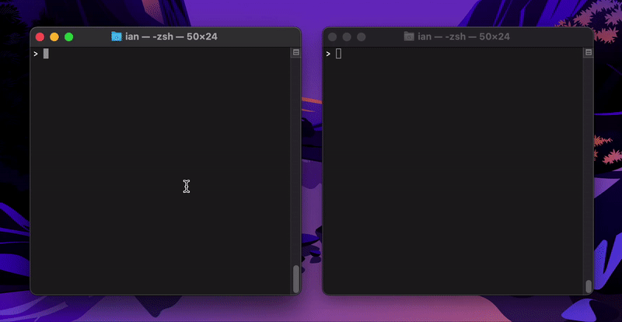
iamlive
SOURCE: https://github.com/iann0036/iamlive
Notes:
This is a neat tool.
IAMLIVE runs on your computer and monitors all API calls you make to your cloud provider, then generates the policies needed to make those calls. I can see this being great for authorizing infrastructure tools, which do tend to have very high access levels.

Slide 49
Processes
Never use Root Access
Encapsulation with Multiple Accounts
Principle of Least Privilege
Regular Security Audits
Regularly Remove Unused Permissions
Notes:
But there is still some work you have to do.

Slide 50
Thank you

Slide 51
References
AWS IAM
Oracle IAM
Google IAM
IBM IAM
HPE IAM
Azure Entra
Alibaba IDaaS
Tencent CAM
MIT CTSS
History of IAM
Kerberos
LDAP
History of Cloud
AWS Services
AWS Permissions
AWS Policy Generator
IAM is the worst
Comments
Policy Sentry
ConsoleMe
AWS Multiple Accounts
Iamlive
AWS Access Advisor
Permissions.cloud
Capital One Breach
Thoughts on AWS IAM

Slide 52


We Are Hiring!
Quality Engineer
Senior Software Engineer
Data engineering
Senior Software Engineer
Manager, software engineer
Staff Software Engineer
System Analysis (EPIC systems)

Slide 54
Appendix

